Slide 1
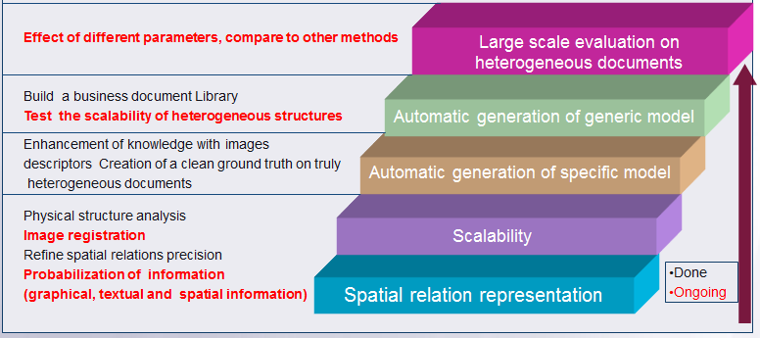
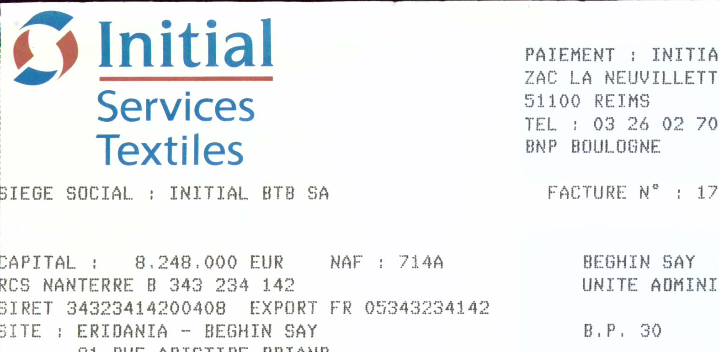
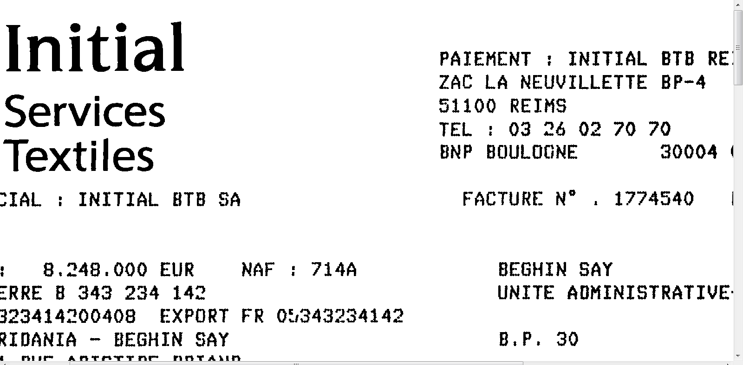
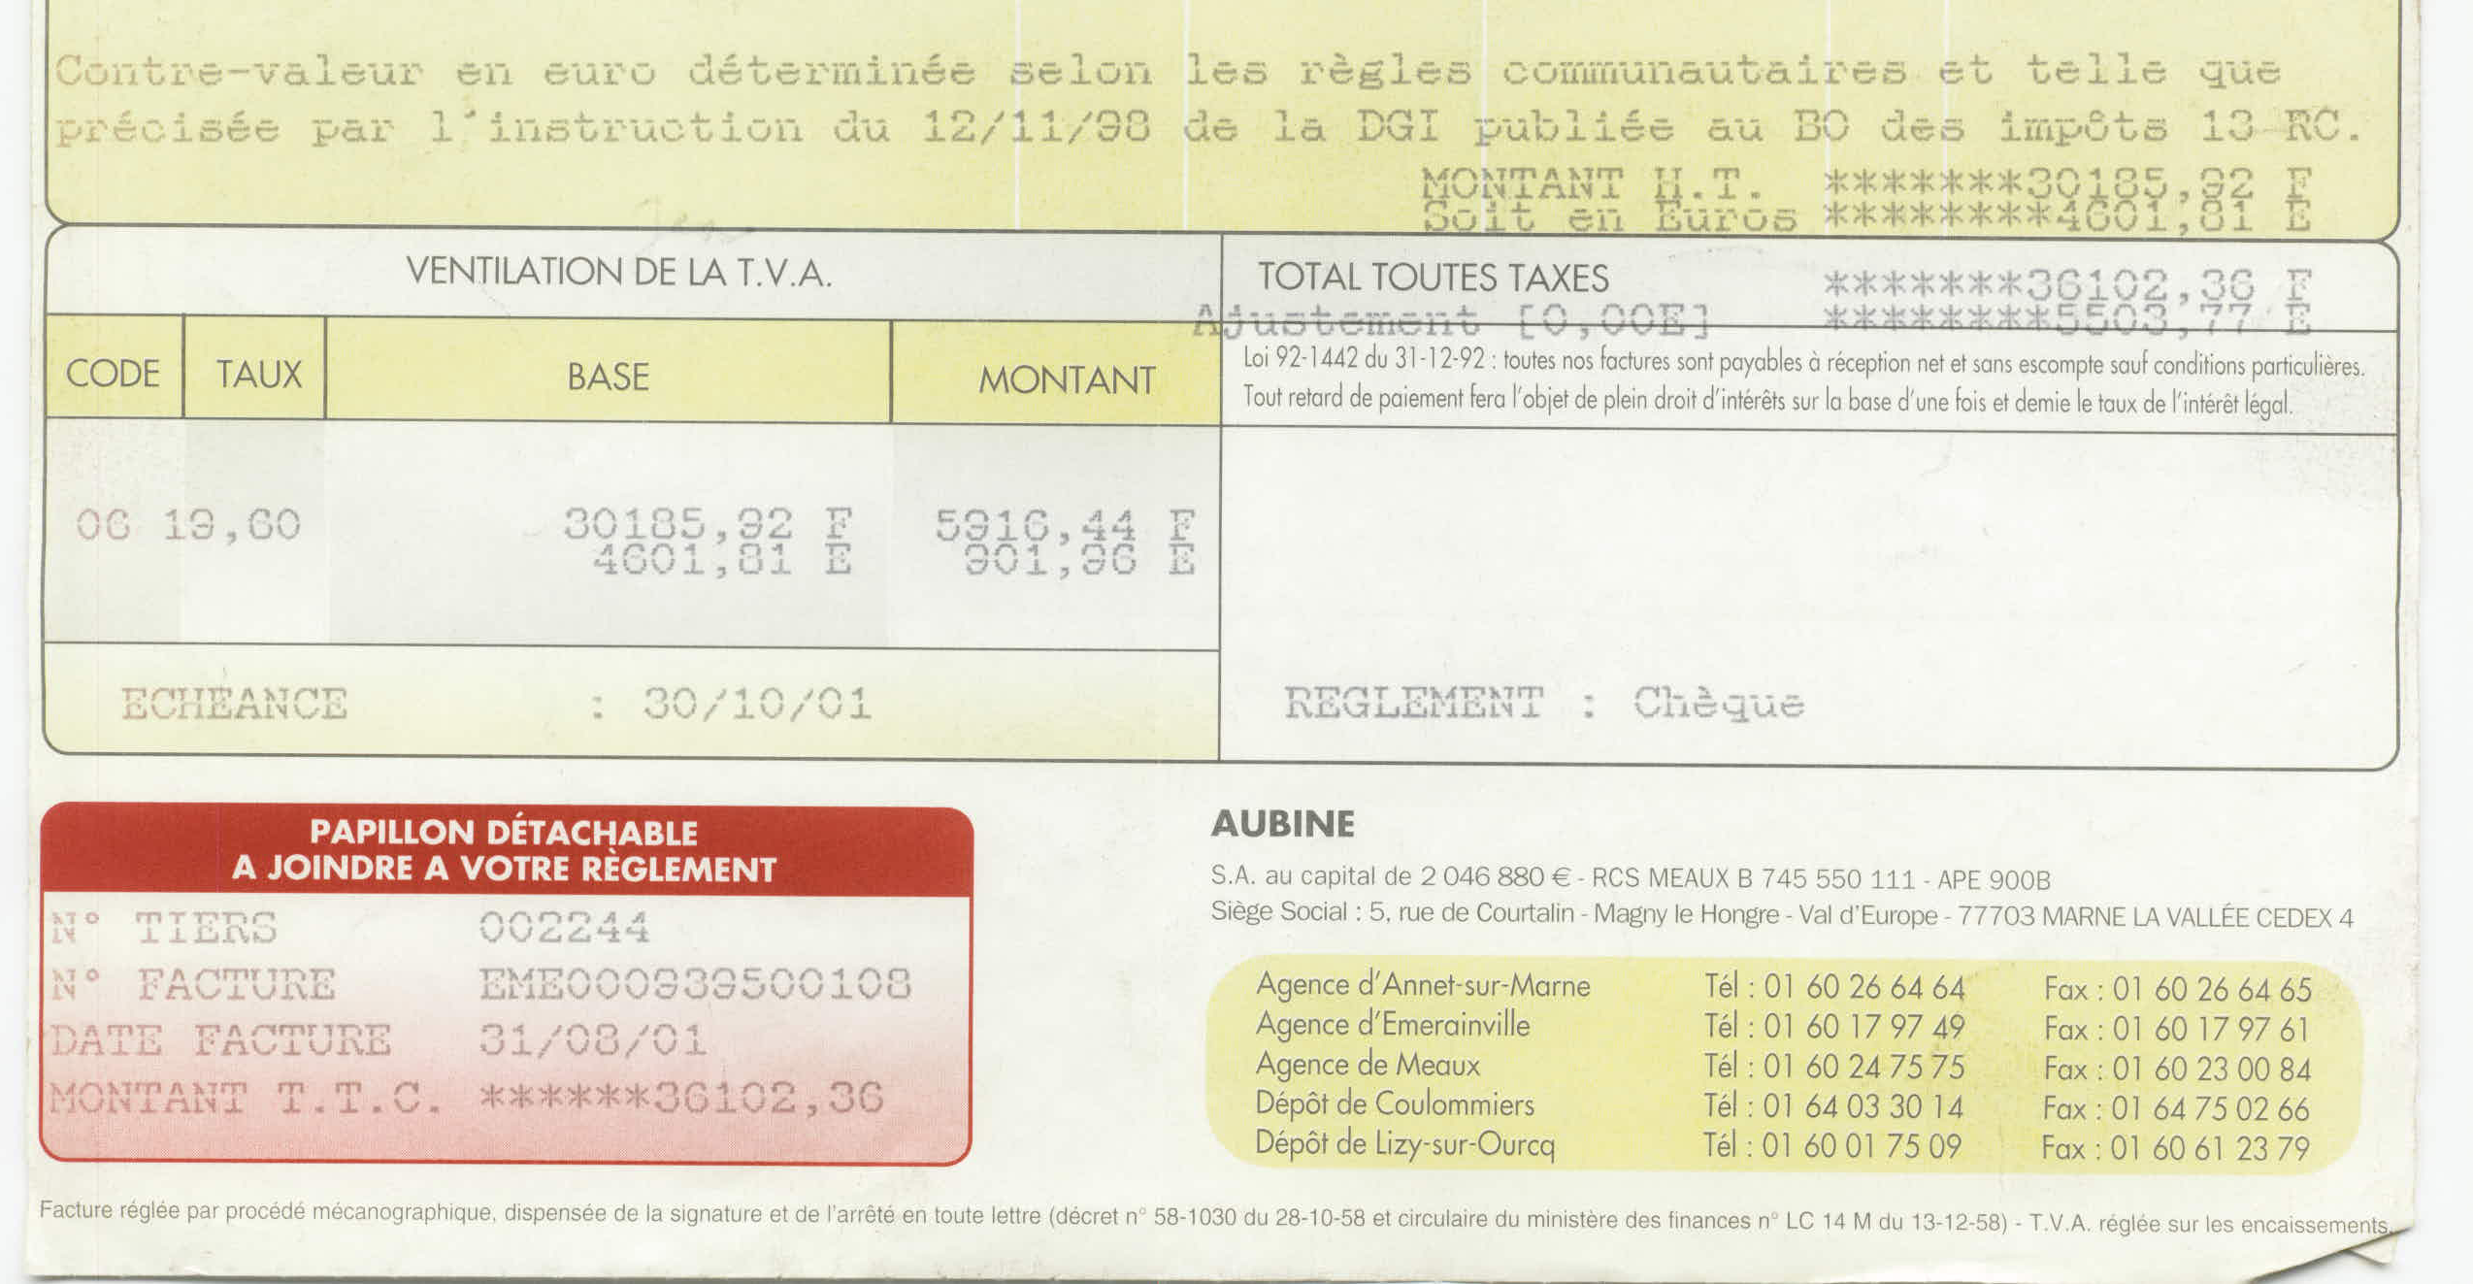
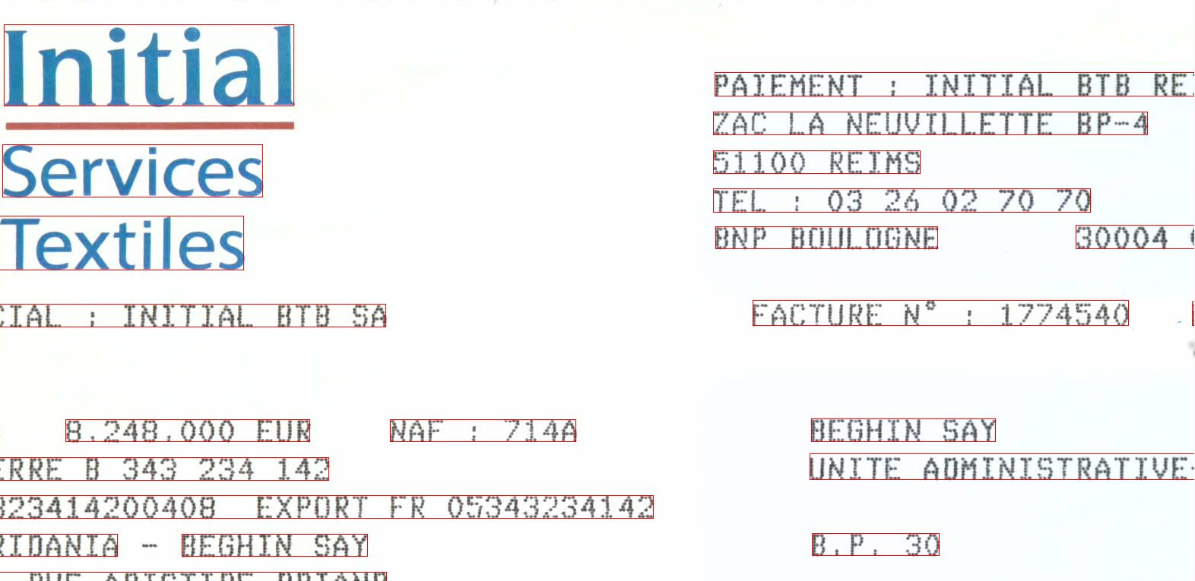
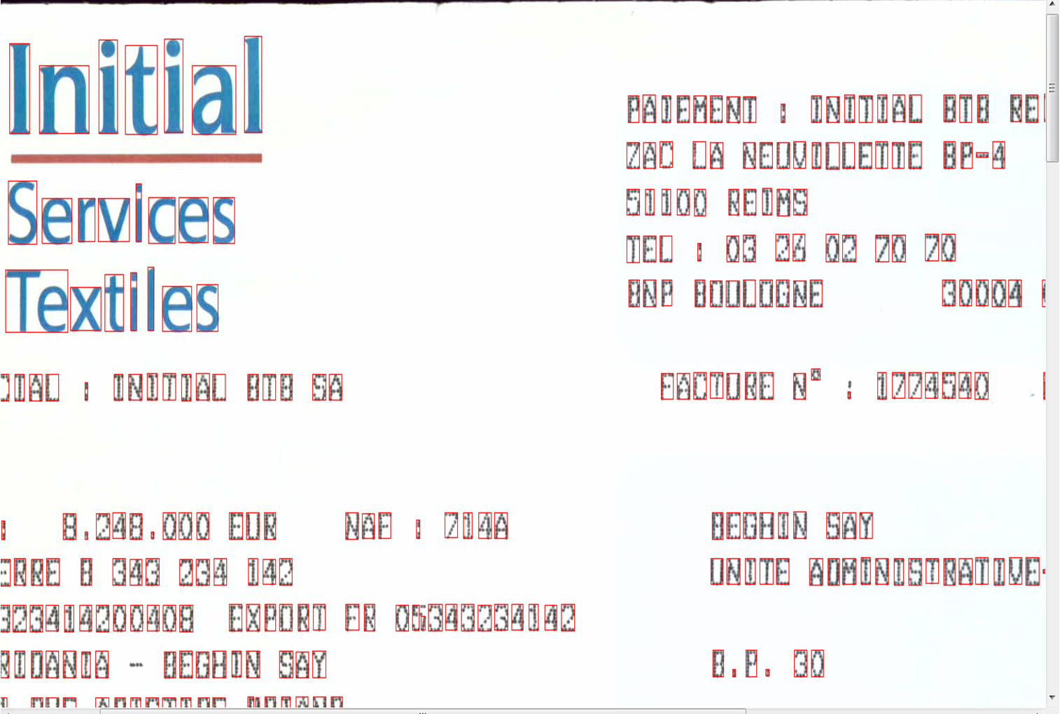
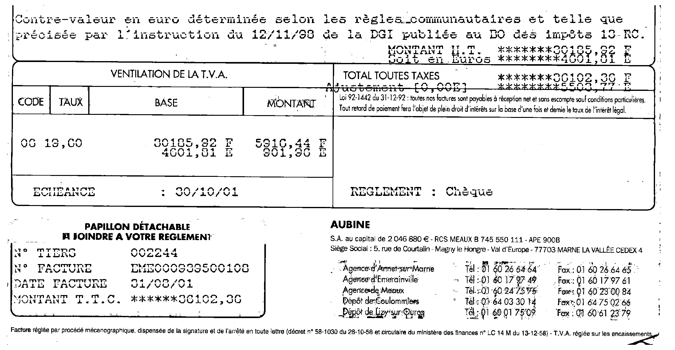
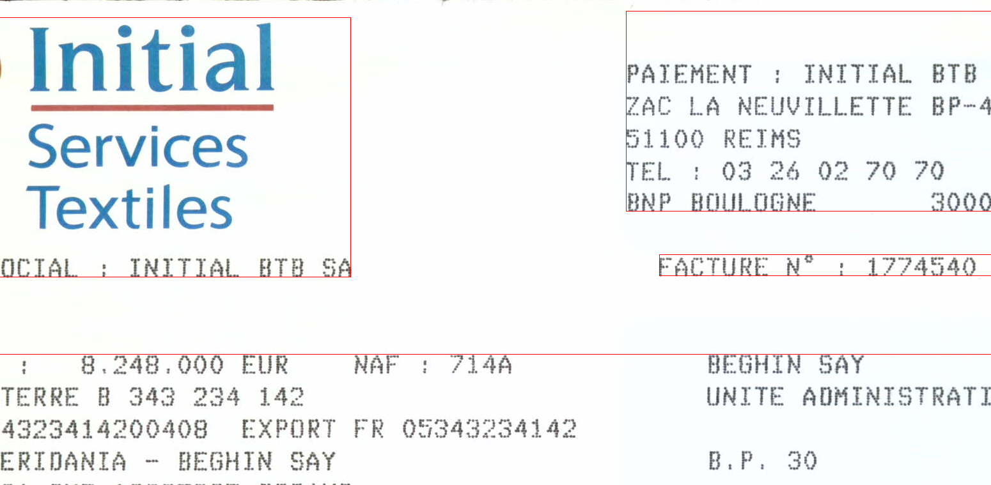
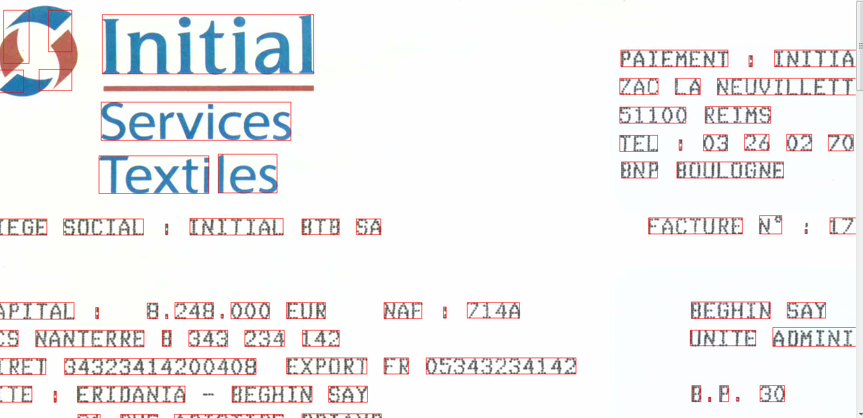
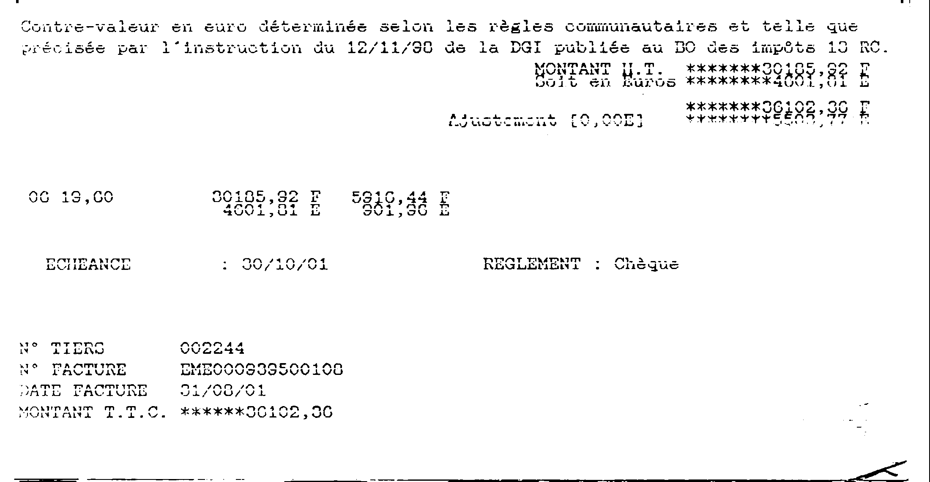
Automatic Modeling and Recognition of Heterogeneous Logical Structures from Digitized Business Documents
Louisa KESSI, Frank LEBOURGEOIS, Christophe GARCIA
LIRIS - Laboratoire d’Informatique en Image et Systèmes d'information, UMR CNRS \INSA de Lyon 5205, F-69621, France.
{ louisa.kessi, franck.lebourgeois,christophe.garcia }@insa-lyon.fr
Abstract and Motivation
My Ph.D. Work -Overview
The main objective: the automatic recognition of document structure by image analysis of highly heterogeneous business documents without any predefined model. Two main complementary directions are provided:
First direction, is to develop an automatic structure recognition system to generate specific model of business documents from the fusion of existing knowledge databases, complemented by exogenous information.
Second direction and most ambitious, is to automatically generalize all existing knowledge databases about business document structures, to derive a sufficiently generic model to recognize all new unknown document whatever its structure.
NLM inter-image for a pixel-based image registration
High Level Color Business Document Layout System
NLM inter-image look for similar neighbourhood from the first image I1 into the second image I2 and provide both an exact image registration with a precision at the pixel level and a noise removal.
Image Original
Morphology called binarisation
a
b
Lignes
Characteres
c
d
e
f
[
Paragraphes
Words
Fig2 shows the original image (a) and its model (b). The split process results into two binary image : the text added (c) and the preprint text (d). The Layout of the preprinted text in blue is displayed in the same image (e) the layout of the added text.
Fig 3 Conected component analysis
http://liris.cnrs.fr/membres?idn=lkessi
Contact : LOUISA KESSI (louisakessi@insa-lyon.fr)

